Slide 1
Tisztelt Hölgyeim es Uraim, kedves Kolleganök es Kollegak. Az AVUS Group es szemelyesen dr. Pscheidl ur, valamint a magam neveben nagy örömmel köszöntöm a budapesti AIDA Kollokviumot !
Budapest 28.11.2014 Ionel D. Dima

Slide 2
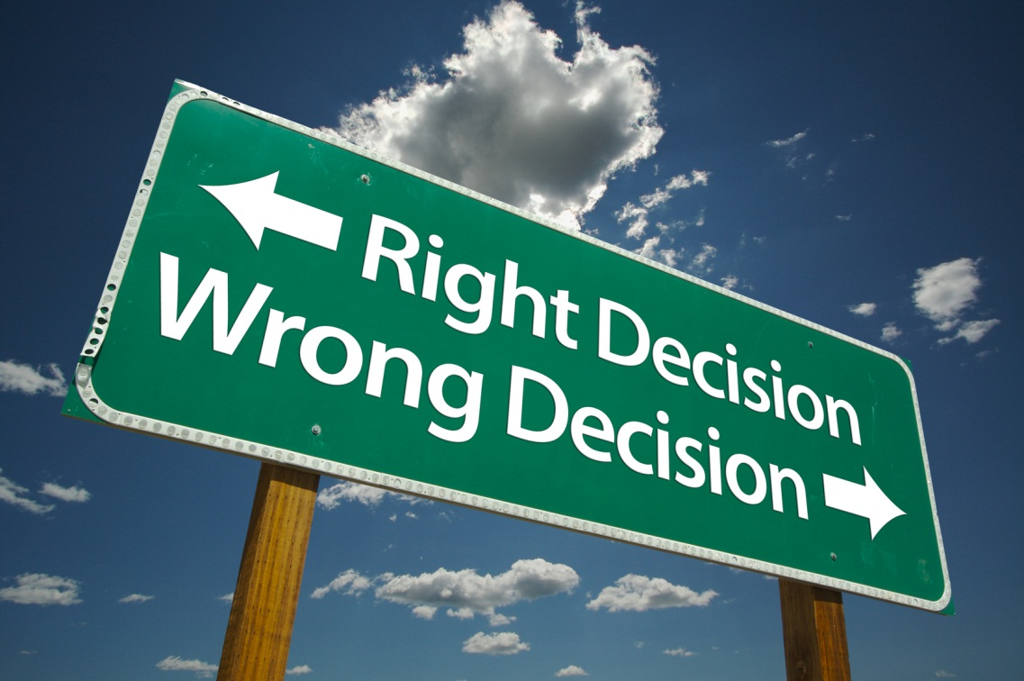
ROMANIA
The problem of moral damages
Ionel D. Dima
Budapest, 28.11.2014

Slide 3
Moral damages
„Honeste vivere, alterum non laedere,
suum cuique tribuere“
(Cicero - De officiis: I, 5, 15)

Slide 4
Definition
Moral damages or otherwise called non-patrimonial damages are physical, psychological and social violations of personal rights or the violation of another right or non-patrimonial interest.
The non-patrimonial damages (moral damages) are those damages which cannot be evaluated in money, as they do not have an economic content.
Pretium DOLORIS;
Pretium AFFECTIONIS;
Pretium PULCHRITUDINIS;
Pretium HEDONE.

Slide 5
Concepts for “moral damages“
In the French civil law:
- préjudice moral, dommage moral
In the Swiss civil law:
le préjudice: - le dommage (economic loss)
- le tort (violation of personal rights)
In the American-English legal system:
- Pain and suffering
- Loss of expectation on life
- Loss of amenity
- Injury of the person

Slide 6
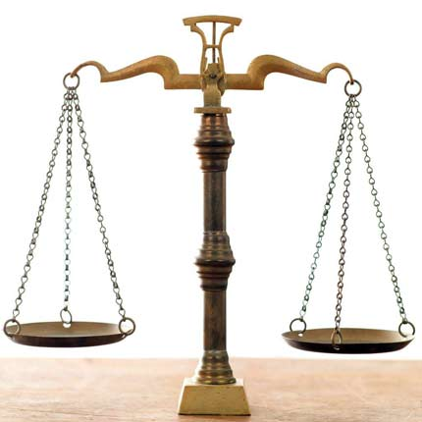
Legal basis
The New Romanian Civil Code “Cod civil“ (since 01.10.2011) stipulates fault-based liability as well as strict liability.
Art. 1357: (1) The person who causes damages to another person by means of an illicit act is obliged to repair the damage.

Slide 7
Principles of the civil liability
Legality
Restitutio in integrum (Art. 1385 Civil Code)
Principle of fault-based liability

Slide 8
Moral damages in case of death
(According to the Street Victims Protection Fund)

Slide 9
Moral damages in case of bodily injuries
Moral damages LEI/day medical treatment in case of invalidity
without invalidity
with invalidity
(According to the Street Victims Protection Fund)

Slide 10
More statistical data
Average indemnity/direct victim | LEI | EUR
In case of death 3.3 claimants/deceased person | 175.000,- | 41.000,-
In case of bodily injuries | 22.000,- | 5.200,-
(According to the Street Victims Protection Fund)

Slide 11
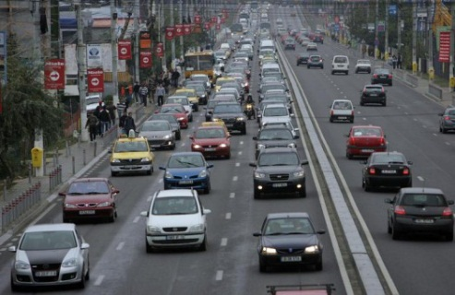
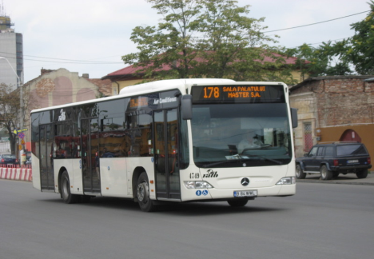
Some figures
Around 2.000.000 registered vehicles
over 5.7 mil. registered vehicles and 6.4 mil. driving licence owners.
But: the streets remained almost in the same condition.
The only “achievement“ is: 530 km highway
1990
2012
79%
10%
0,71%
(According to the General Inspectorate of the Romanian Police)

Slide 12
Dynamics of the serious traffic accidents
(2007-2012)
(According to the General Inspectorate of the Romanian Police)

Slide 13
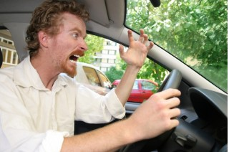
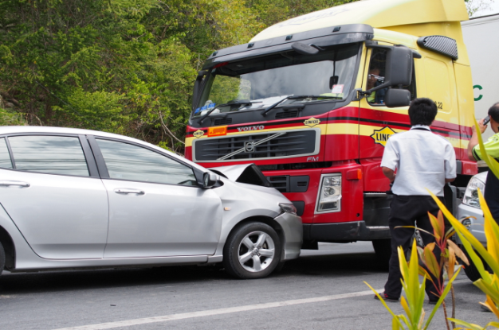
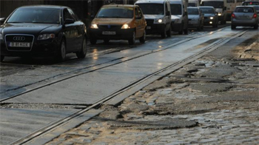
Causes of traffic accidents
People (90%)
Technology (small percentage)
Infrastructure
(According to the General Inspectorate of the Romanian Police)

Slide 14
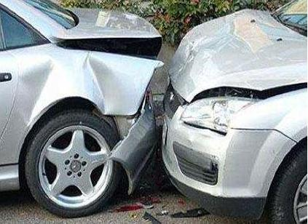
Traffic accidents 2012
26.648 traffic accidents with human victims: 2.040 deceased,
8.768 severely injured and 24.723 slightly injured
67.380 traffic accidents only with material damages (Police report)*
* The number of the traffic accidents which have been solved based on European Accident Report is unknown
(According to the General Inspectorate of the Romanian Police)

Slide 15
Green Card System
Evolution of the number of damage cases
1999 291.730
2000 337.361
2005 342.963
2009 345.746
2011 371.271
Source: CoB

Slide 16
Average damages Romania
Material damages: EUR 2.500,-
Personal damages: EUR 14.000,-
Aggregate: EUR 8.000,-

Slide 17
Some examples
EUR 302.315,70 moral damages in Court for 9 parties ……………… 2012
EUR 132.756,78 moral damages in Court for 2 parties ……………………… 2012
EUR 78.391,52 moral damages out of Court for 3 parties …………………. 2013
EUR 61.115,- moral damages in Court for 3 parties ………………………. 2013
EUR 57.213,96 moral damages in Court for 3 parties ………………………. 2012

Slide 18
JURISPRUDENCE
Case Studies
Realities

Slide 19
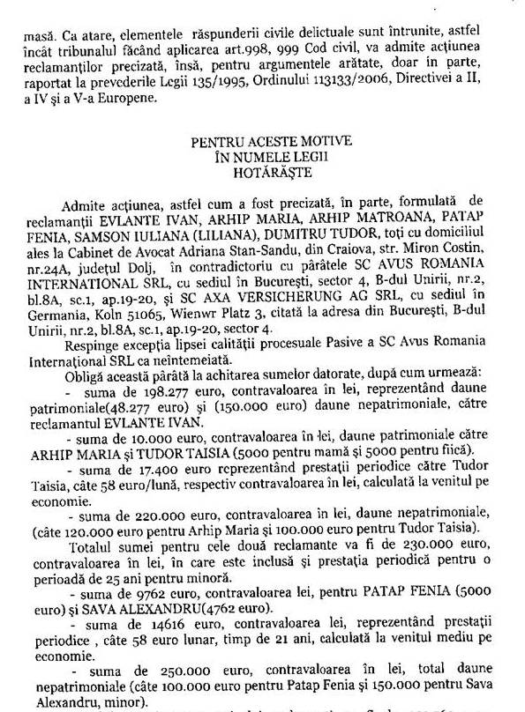
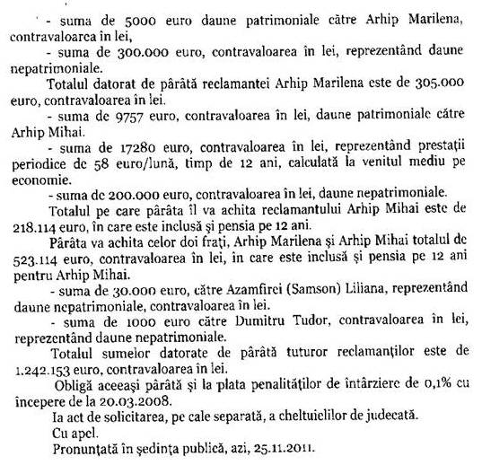
1st Instance: Tribunal Bucharest
Civil Sentence from 25.11.2011
- Accident from 19.07.2007
- 2 injured parties + 4 deceased persons.
Total amounts granted:
EUR 1.242.153 + 0.1% interest from 2008

Slide 20
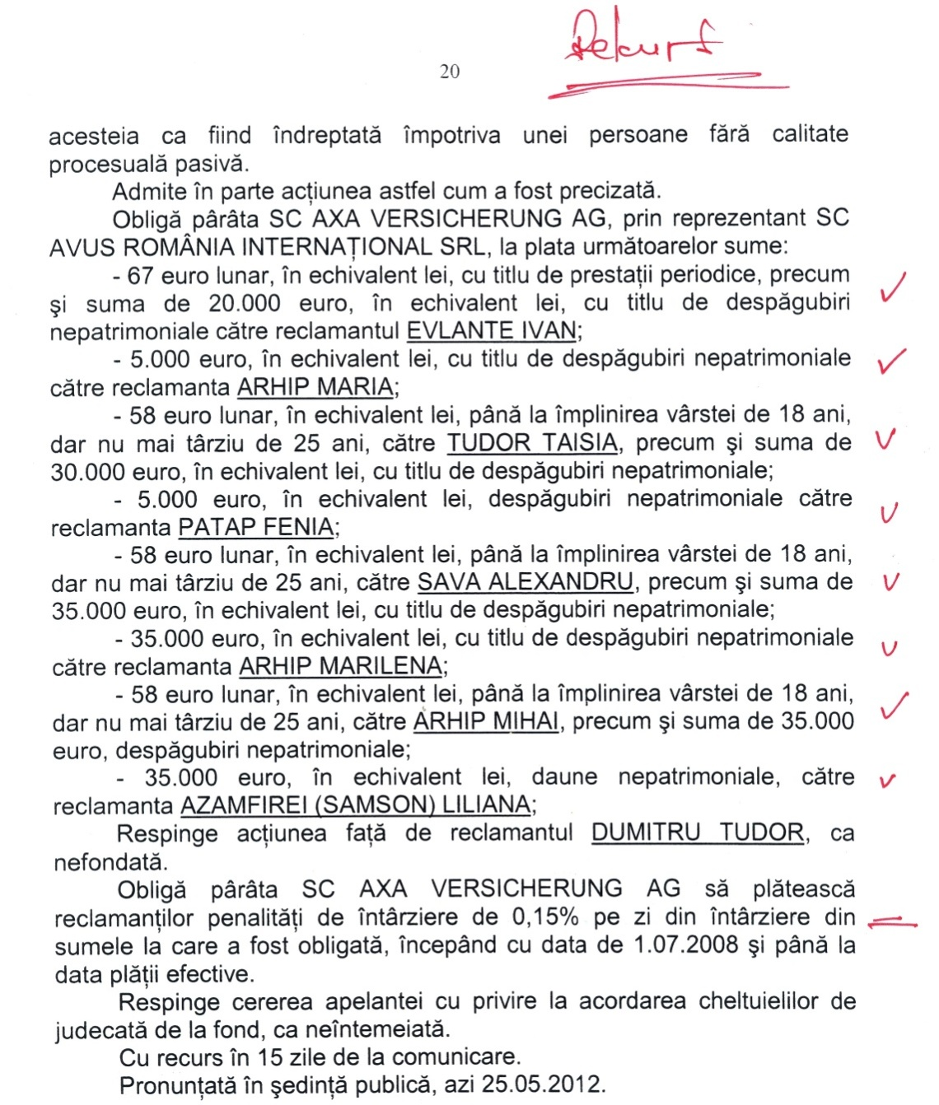
2nd Instance: Appeal Court Bucharest
Civil Decision from 25.05.2012
The amounts were reduced to EUR 200.000,-!!!

Slide 21
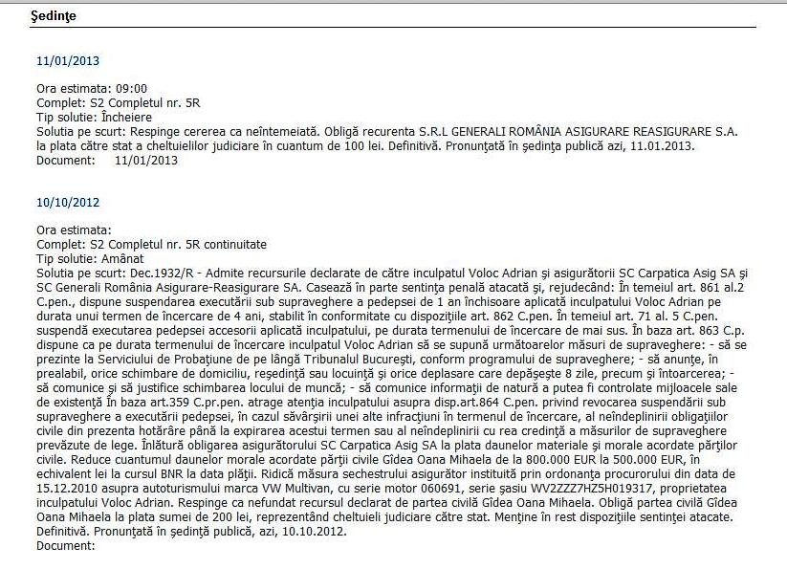
Accident from 05.03.2010 in RO Injured party: pedestrian (16 years old, 150 days of medical care+invalidity) Moral damages in 1. Instance: EUR 800.000,- and in 2. Instance: EUR 500.000,-
Decision of the Appeal Court Bucharest from 10.10.2012

Slide 22
Accident from 16.04.2009 in RO A deceased child (3 years old) A severely injured child (4 years old): 80 days of medical care+invalidity Moral damages for the parents of the deceased: LEI 2.000.000,- Moral damages for the injured: EUR 300.000,- and material damages EUR 200.000,-
Decision of Court of Law Pitesti from 06.12.2010, in force according to the
Decision of the Appeal Court Pitesti from 22.03.2011

Slide 23
Accident from 12.07.2009 in RO Injured party: 80 days of medical care + invalidity Moral damages: EUR 1.200.000,- !!!
Decision of Court of Law Bucharest Sector 2 from 26.05.2011 in force according to the Decision of the Appeal Court Bucharest from 18.10.2011

Slide 24
1. How are the insurers acting in a case with a deceased person/ injured party ?
a) wait for the trial to start and then pay the indemnities based on a Court decision; b) try to settle the claims out-of-Court as soon as possible.

Slide 25
CLAIMS SETTLEMENT Contrastive analysis between settlement of claims in Court, based on Court’s Decision and out of Court settlement
 | CASE 1 claims settled out of Court | CASE 2 claims settled in Court based on Court's Decision
Acc. date / Place | 09.10.2010 in Romania | 03.12.2009 in Romania
TPL Insurer | BG | BG
First notification of the case | 22.08.2012 (2 years after Acc. date) | 27.02.2013 (3,3 years after Acc. date)
First indicated Reserve | Pers: Eur 100.000 / mat: Eur 50.000 | Pers: Eur 50.000 / mat: Eur 20.000
Reserve after 1 month: |  | Pers: Eur 800.000 / mat: Eur 30.000
Reserve after 6 months: | Pers: Eur 500.000 / mat: Eur 20.000
Reserve after 9 months: | Pers: Eur 200.000 / mat: Eur 50.000

Slide 26
CASE 1 | CASE 2
Dynamics of the accident: | frontal impact Insured enters the opposite traffic way and collided the TP’s vehicle | Insured lost control over the vehicle and crashed against a tree
 | Insured: RO citizen driving a BG matriculated vehicle * No alcohol | Insured: RO citizen driving a BG matriculated vehicle * No alcohol, speed (71Km/H) over the allowed limit (50 Km/H)
Consequences: | 4 persons lost their lives – 1 person in the TP’s vehicle and 3 in the Insured’s vehicle, incl. the driver 1 person with severe bodily injuries | 4 passengers in the Insured's vehicle lost their lives, but the driver
Criminal investigation: | 15 months (the perpetrator deceased as a result of the accident, investigated for 3 infractions of manslaughter and 1 infraction of causing bodily injuries) | 39 months The responsible driver sued at law for manslaughter due to negligence
Resolution of the Prosecution authorities issued on: | 10.01.2012 | 25.02.2013

Slide 27
CASE 1 | CASE 2
Victims: | 1 person in the TP's vehicle (female, 51 years old) | 1 child deceased (5 years old) 3 adults deceased (18-48 years old)
 | 3 persons in Insured's vehicle lost their lives | 1 person injured (male, 48 years old)
Who formulated claims? | - TP, 53 years old, 3rd degree of disability | 15 civil parties claimed for indemnities:
 | for the suffered bodily injuries | - parents of the victims
 | 90 medical attendance days | - brothers and sisters of the victims
 | and for the death of his wife, 51 years old | - wives
 | - TP's son for the death of his mother | - children of the victims: 2 minor children.
Formulated claims: | Eur 2.000.000 as moral damages | Eur 1.320.000 as moral damages
 | Eur 1.700 as material damages | Eur 6.500 as material damages and alimonies for the 2 minors

Slide 28
CASE 1 | CASE 2
Action in Court: | civil action TRIBUNAL BUCHAREST | criminal case COURT OF LAW BUFTEA
Agreement of the TPL Insurer for the out of Court settlement: | YES | NO
Possibility for the out of Court settlement? | YES | YES
Claims settled by means of agreed Transactions: | YES | NO
Claims settled definitely to Indemnities paid: | EUR 60.000 YES | NO
Transaction included: claims for the deceased wife claims for the suffered bodily injuries claims of the son for his mother's death all costs related to the accident judicial, lawyer fees, etc.

Slide 29
CASE 1: | Out of Court settlement
CASE 2: | Criminal judgment issued on 12.06.2013 granted:
Court’s Decision | Eur 50.000 (each) as moral damages | Mothers of the victims
 | Eur 50.000 (each) as moral damages | Fathers of the victims
 | Eur 50.000 | Daughter of the victim and mother of the deceased son
 | Eur 50.000 | Wife of a deceased victim and daughter of another victim
 | Eur 50.000 as moral damages | Wife of a deceased victim
 | Eur 20.000 (each) as moral damages | Sisters of the victims
 | Eur 20.000 as moral damages | Son of a deceased victim
 | Eur 20.000 as moral damages | Son of a deceased victim
 | Eur 20.000 + alimony | Daughter of the victim (minor)
 | Eur 20.000 + alimony | Daughter of another victim (minor)
 | Eur 5.000 as moral damages | Sister of a victim
 | Eur 5.000 as moral damages | Brother of a victim
 | Eur 5.000 as moral damages | Brother of a victim
 | Eur 5.000 as moral damages | Brother of a victim
 | EUR 350.000 TOTAL INDEMNITIES granted as moral damages
 | the criminal Judgment is not yet definite; recourses have been submitted by all parties - the Recourse Instance is Court of Appeal Bucharest – where – 90% of the decisions are maintained as decided by the first Instance.

Slide 30
CASE 1 | CASE 2
CONCLUSIONS | Formulated claims: EUR 2.001.700 | Formulated claims: EUR 1.320.000
 | claims settled out of Court to EUR 60.000 | indemnities granted by Court's Decision: EUR 350.000

Slide 31
The phenomenon “moral damages”: Tendencies
The phenomenon “moral damages” has registered a fast, out-of-control increase in the last 5 years and in the last 2 years it has become a real danger.
The jurisdiction of the Courts is not unitary.
There are no objective criteria based on which the magistrates can quantify the moral damages.
No need for evidence in the case of close relatives: husband, wife, children, brothers and sisters, parents, grand-parents.

Slide 32
INDEMNITIES GRANTED IN COURT AS MORAL DAMAGES RELATED TO THE NUMBER OF DAYS FOR MEDICAL ATTENDANCE – PERSONS SUFFERING BODILY INJURIES
Area – which Court of Law granted the indemnities;
Age of the person, gender;
No. of necessary days for healing based on the medico legal certificate
Granted compensation

Slide 33
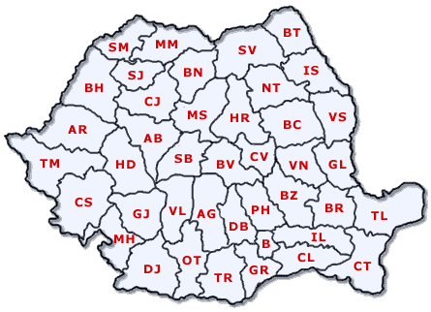
CRAIOVA – South area Court of Appeal Craiova
EUR 8.900
15 years old, male, minor
16-18 days of medical attendance
for healing according to the medico legal certificate

Slide 34
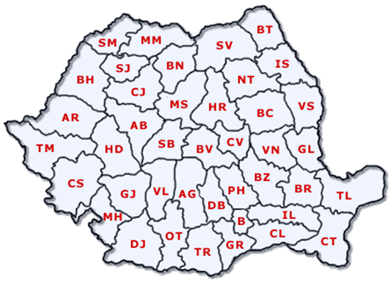
GIURGIU – South area Court of Law Giurgiu
EUR 3.600
48 years old, female
30-35 days of medical attendance
for healing according to the medico legal certificate
EUR 6.600
57 years old, female
70 days of medical attendance for healing according to the medico legal certificate (infirmity, lost an eye as a result of the accident)

Slide 35
MARAMURES – NORTH AREA COURT OF LAW SIGHETU MARMATIEI
EUR 500 (!!!)
49 years old, female
40-45 days of medical attendance
for healing according to the medico legal certificate

Slide 36
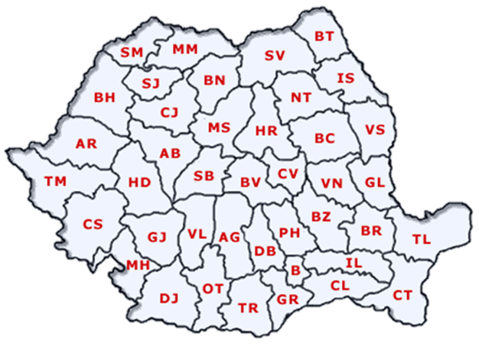
CONSTANTA – SOUTH EAST AREA Court of Appeal Constanta
EUR 4.500
37 years old, male
45-50 days of medical
attendance
EUR 50.000 37 years old, male 180-190 days of medical attendance
EUR 80.000
9 years old, male, minor
90-100 days of medical attendance

Slide 37
BUCHAREST – SOUTH AREA Court of Appeal Bucharest
EUR 68.000 (!!)
40 years old, female
50-55 days of medical attendance
for healing according to the medico legal certificate
* the Decision is not definite / irrefutable yet;

Slide 38
PITESTI – SOUTH AREA
COURT OF LAW PITESTI
EUR 9.000
76 years old, female
80 days of medical attendance
for healing according to the medico legal certificate

Slide 39
RAMNICU VALCEA – SOUTH AREA
COURT OF LAW RAMNICU VALCEA
EUR 4.500
85 years old, female
80-90 days of medical attendance
for healing according to the medico legal certificate

Slide 40
ADJUD – EAST AREA
COURT OF APPEAL GALATI
EUR 40.000
61 years old, male
90-100 days of medical attendance
for healing according to the medico legal certificate

Slide 41
TIMISOARA – WEST AREA COURT OF APPEAL TIMISOARA
EUR 30.000 10 years old, male, minor
180 days of medical attendance for healing according to the medico legal certificate PS: contributory negligence for the accident: 50%:50%

Slide 42
Comments:
Criteria for the a.m. 12 cases:
1. medico legal certificate
2. granted compensation in Court
70% of the indemnified victims = pedestrians
The victims: minors, pensioners and unemployed

Slide 43
TIDBIT:
When the first 1 Million Euro compensation was granted, a colleague in the insurance field, very active in studying the problem of the huge compensations, established by the judges in the Court of Law, made a simple mathematical exercise:
1 Million Euro = RON 4.000.000 = LEI 40.000.000.000
divided by 60 seconds - divided by 60 minutes
divided by 24Hours - divided by 365 days (1year)
resulted the necessary time that person needed to count the money he received: 1.268 years!
PS: the rate of exchange refers to March, 2012

Slide 44
Whereas the Europe Nordic countries consider the death a risk of life (no compensations are paid in favor of the relatives), in Romania the average moral damage sums up to Eur 14.000.
If we had to correlate this value to the monthly net income: 40 wages in RO whereas in other European countries this value represents 9,10 wages
The RO justice should understand that the Insurer is just an instrument, who returns the money to the entitled persons by using a balanced and honest, righteous way of settlement.
Granting moral damages should not mean to get revenge on Insurers because – as the German principle asserts: Who uses, gets protection (Wer nützt, der schützt).
We still haven’t found the answer to the question: how much does it costs a person’s life?

Slide 45
On the other hand, the Insurer should be very open and interested in carrying negociations with the claimants, with the attempt of the out of Court settlement.
It is well known that only by the simple meeting between litigants (sitting together at the negotiations table) for discussing the issue, could be finalized with a good result or it may succeed in reaching an agreement.
Juridically speaking, the mere fact that two lawyers open in the same time their files related to a case and read the documents, might have as result an agreement (Prof.Dr. Frank E.A.Sander, Harvard Law School, about the placebo phenomena)

Slide 46
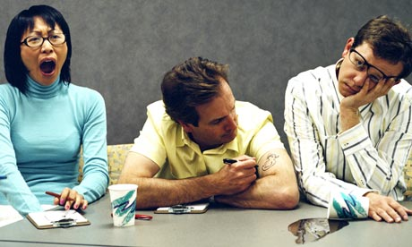
Thank you ! Nagyon kösönöm es remelem nem untattam Önöket !
www.avus-group.com

